Slide 1
18-349: Introduction to Embedded Real-Time Systems
Lecture 12: Mid-Term Review
Anthony Rowe
Electrical and Computer Engineering
Carnegie Mellon University

Slide 2
Administrivia
Lab 2 checkpoint Today
Lab 2 due next Monday (Oct. 17th)
Mid-Term Exam on Wednesday
Open book / note
Will cover everything from lecture up to this point
We will hit some highlights today

Slide 3
Previous Lecture
Direct Memory Access (DMA)
Double Buffering
Processes
Processes vs Threads
Context Swap
TCB

Slide 4
Mid-Term Logistics
Takes place during normal lecture
Open book / open note
Bring a calculator!
No electronic communication (laptop and cellphone are not allowed)
Format
Approximately 6 questions
Mix of multiple choice and short answers
Comprehensive, but with a focus on what is not tested by the labs

Slide 5
Overview
L1 – What is embedded?
L2 – ARM Architecture
L3 – ARM ASM
L4 – Memory Mapped I/O
L5 – Serial Buses
L6 – Timers and Interrupts
L7 – SWI
L8 – ADC and DAC
L9 – Transducers
L10 – ARM Optimization and Profiling
L11 – DMA and Processes

Slide 6
Lecture 1: Intro to Embedded
What are embedded systems?
How is embedded different?
Size, Power, Harsh Environments, Safety-Critical, Cost, Interfaces with Physical world
Memory
Network
Cache
Microcontroller
Sensors
A/D
CPU
D/A
Actuator
Distributed!
Diagnostic
tools
MMI
I/O
Auxiliary Systems
(power, cooling)
Electro-mechanical
backup and safety
External
Environment
Memory
Memory
Network
Cache
Microcontroller
Network
Cache
Sensors
A/D
CPU
D/A
Actuator
Microcontroller
Sensors
A/D
CPU
D/A
Actuator
Diagnostic
tools
MMI
I/O
Auxiliary Systems
(power, cooling)
Diagnostic
tools
MMI
I/O
Auxiliary Systems
(power, cooling)
Electro-mechanical
backup and safety
Electro-mechanical
backup and safety
External
Environment
External
Environment

Slide 7

Overview of Fundamentals
Instructions, machine code
Instruction cycle, fetch cycle
Basics of interrupts
The memory pyramid
Caches
Pipelining
Big endian vs. little endian
Memory areas of a program
Moore’s Law
RISC vs. CISC

Slide 8
Lecture 2: ARM Architecture
CISC vs RISC
Register Mapping / Modes
Modes
Register Banking
Exception vs Interrupt
Why do we have them?

Slide 9
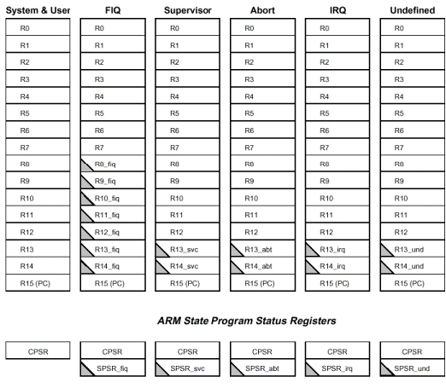
Register Set
1
2
3
4
5
6
7
8
9
14
15
16
17
18
21
22
10
11
12
13
19
20
23
24
25
26
27
28
29
30
31
32
33
34
35
36
37
Notes:
6 different R13 registers

Slide 10
Lecture 3: ARM ASM
Pipelining
What is it?
Why do we do it?
ASM Instructions
Bring the ASM cheat sheet!
Barrel Shifter
Conditional Instructions
Addressing Modes
Load/Store Multiple

Slide 11
Traditional ARM Pipeline
ARM traditionally employed a 3-stage pipeline with the following stages
Fetch: instruction fetched from memory
Decode: instruction is decoded
Execute: instruction is executed
When processor is executing simple data processing instructions the pipeline enables one instruction to be completed every clock cycle
1
fetch decode execute
2
fetch decode execute
3
fetch decode execute
time

Slide 12
The ARM Barrel Shifter
Data processing instructions are processed within the ALU
ARM can shift the 32-bit binary pattern in one of the source registers left or right by a specific number of positions before the value enters the ALU
Can achieve fast multiplies or division by a power of 2
Data-processing instructions that do not use the barrel shifter
MUL (multiply)
CLZ (count leading zeros)
QADD (signed saturated 32-bit add)
Rn
Rm
No pre-processing
Pre-processing
Result N
Arithmetic and Logic
Unit (ALU)
Rd

Slide 13
Value of Conditional
This improves code density and performance by reducing the number of forward branch instructions
if (x != 0) CMP r3,#0 a = b+c; BEQ skip else ADD r0,r1,r2
a = b–c; B afterskip
skip
SUB r0, r1, r2
afterskip
CMP r3,#0 ADDNE r0,r1,r2
SUBEQ r0,r1,r2

Slide 14
Addressing Modes
Preindex
Same as preindex with writeback, but does not update the base register
Example: LDR r0, [r1, #4]
Preindex with writeback
Calculates address from a base register plus address offset
Updates the address in the base register with the new address
The updated base register value is the address used to access memory
Example: LDR r0, [r1, #4]!
Postindex
Only updates the base register after the address is used
Example: LDR r0, [r1], #4

Slide 15
Multiple-Register Transfer
Load-store-multiple instructions can transfer multiple registers between memory and the processor in a single instruction
Advantages
More efficient than single-register transfers for moving blocks of data around memory
More efficient for saving and restoring context and stacks
Disadvantages
ARM does not interrupt instructions when executing a load-store multiple instructions can increase interrupt latency
Compilers can limit interrupt latency by providing a switch to control the max number of registers that can be transferred on a load-store-multiple
LDM<cond><addrMode> Rn{!}, <registerList>{^}
STM<cond><addrMode> Rn{!}, <registerList>{^}
Notes:
{^} – denotes user registers from supervisor mode
{!} – write back (update Rn address when done)

Slide 16
Lecture 4:
Memory Mapped I/O
Why?
How is it used?
Volatile
Why?
When should it be used?

Slide 17
Thoughts on volatile
What does the keyword volatile accomplish?
Tells the compiler not to perform certain optimizations
Tells the compiler not to use the cached version of the variable
Indicates that that variable can change asynchronously
Some compilers allow you to declare everything as volatile
Don’t! It’s a substitute for good thinking
Can lead to less efficient code
Don’t blame the optimizer and don’t turn it off
If you are given a piece of code whose behavior is unpredictable
Look for declarations of volatile variables
Look for where you should declare a variable as volatile

Slide 18
Lecture 5: Serial Buses
Serial vs Parallel
Why choose one over the other?
Asynchronous vs Synchronous Communication
Know your buses!
UART, SPI, I2C
What are the trade-offs?
Serial Bus Concepts
Framing (start/stop bits)
Baudrate
Error checking (parity)

Slide 19
Serial vs. Parallel
MCU 1
MCU 2
Serial
TX
RX
MCU 1
signal
MCU 2
Data[0:7]
Parallel

Slide 20
Sync vs. Async
Synchronous communications
Requires common clock (SPI)
Whoever controls the clock controls communication speed
Asynchronous communications
Has no clock (UART)
Speed must be agreed upon beforehand (the baud-rate configuration accomplishes that)

Slide 21
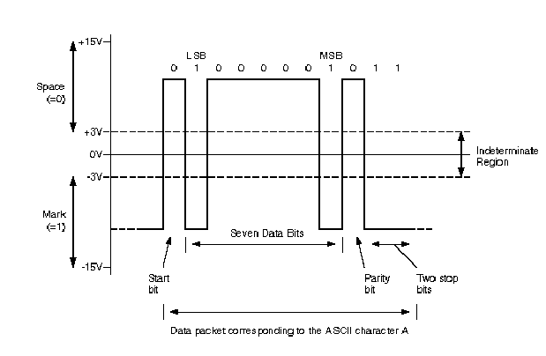
UART
Source: Dallas Semiconductors
Application note 83
Notes:
21
With 1 or 2 stop bits the line output is held at the mark level for 1 or 2 times a bit duration.
With 1.5 stop bits imply that the line output is held at the mark level for 1.5 times a single bit duration, useful in detecting certain synchronization errors because if there is an immediate character to be TX/RX next it’s start bit would cause a change in the voltage level in the middle of a bit signifying the definite presence of a stop bit
Width of a bit is determined by baud rate. 9600 baud, 1 bit=1/9600=0.104 mS. So, start bit would be held for 0.104ms

Slide 22
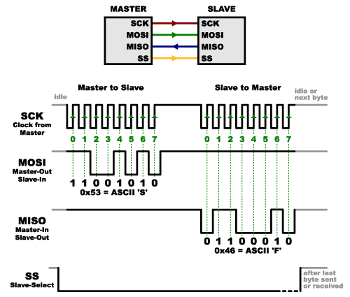
SPI Communication

Slide 23

I2C
First byte of transfer contains the slave address and the data direction
Address is 7 bits long, followed by the direction bit
Like all data bytes, address is transferred with the most significant bit first
7-bit address space allows for 128 unique I2C device addresses
16 addresses are reserved for special purposes
Leaves only 112 addresses with this 7-bit address scheme
New 10-bit address scheme has been introduced
“General call” broadcast – to address every device on the bus
What is the maximum number of devices in I2C limited by?
Notes:
The maximum number of nodes is obviously limited by the address space, and also by the total bus capacitance of 400 pF.

Slide 24
Lecture 6: Timers and Interrupts
What is a timer?
Polling vs. Interrupt Driven
What is the difference?
When using Polling?
When use Interrupts?
Implications around Interrupts
FIQ vs. IRQ
Nest vs. non-nested

Slide 25
What is a Timer?
A device that uses a high­speed clock input to provide a series of time or count-related events
Counter Register
System Clock
0x1206
Reload on Zero
÷
000000
Clock Divider
Countdown Register
Interrupt to Processor
I/O Control

Slide 26
Polling vs. Interrupt­Driven I/O
Polling requires code to loop until device is ready
Consumes lots of CPU cycles
Can provide quick response (guaranteed delay)
Interrupts don't require code to loop until the device is ready
Device interrupts processor when it needs attention
Code can go off and do other things
Interrupts can happen at any time
Requires careful coding to make sure other programs (or your own) don't get messed up
What do you think real-time embedded systems use?

Slide 27
Lecture 7: Software Interrupts
System Calls
What are they?
Why are they useful?
How are the implemented?
SWI overview for ARM

Slide 28
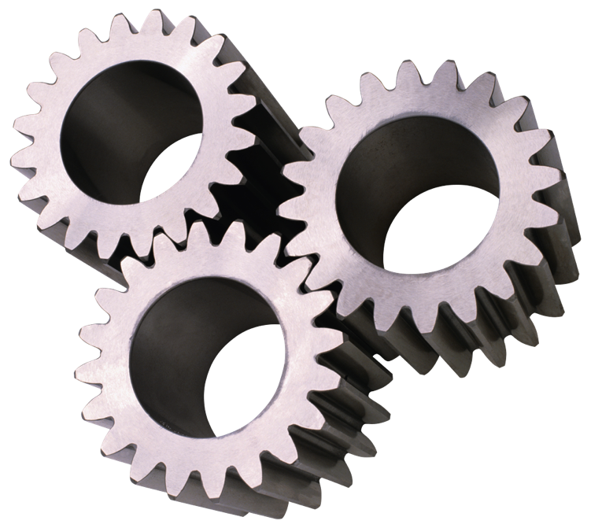
System Calls
Application Program
fread()
Standard C Library
swi
Operating System
Hardware Device
Driver
Hardware
Device

Slide 29
Vectoring to an SWI
Vector Table
starting at 0x00 in memory
SWI Handler
(S_Handler)
USER Program
0x00
0x04
0x08
0x0c
0x10
0x14
0x18
0x1c
LDR pc, [pc, 0x100]
LDR pc, [pc, 0x100]
LDR pc, [pc, 0x100]
LDR pc, [pc, 0x100]
LDR pc, [pc, 0x100]
LDR pc, [pc, 0x100]
LDR pc, [pc, 0x100]
LDR pc, [pc, 0x100]
ADD r0,r0,r1
SWI 0x10
SUB r2,r2,r0
2
“Jump” Table
3
MOVS pc, lr
0x108
0x10c
0x110
0x114
...
&A_Handler
&U_Handler
&S_Handler
&P_Handler
...
softvec

Slide 30
Lecture 8: ADC and DAC
Understand converting between physical phenomena -> Engineering units in a CPU
ADC and DAC
Concepts
What is anti-aliasing?
Physical
Phenomena
Voltage or
Current
ADC Counts
Engineering Units
Sensor
ADC
Software

Slide 31
Lecture 9: Transducers
Sensors
Types and properties
Actuators
Types and properties
Sampling Rate and Resolution
Not much if any digital filtering since it has not been covered in lab yet

Slide 32
Lecture 10: Optimization
System Profiling
What can we measure and how?
Optimization Techniques
Understand what smart compilers do under the hood
Trade-offs
Performance vs. Size
Negative Instruction-cache effect

Slide 33
Optimization Overview
Code Optimization Techniques
Processor independent compiler optimizations
Common sub-expression elimination
Dead-code elimination
Induction variables
In-lining of functions
Loop unrolling
ARM specific optimization
Count-down loops
Register spilling
Efficient use of global variables
Space Optimization

Slide 34
Lecture 11:
DMA
Really important natural extension of MMIO
Double Buffering
Downplayed on exam since it hasn’t been covered in lab yet
Process vs Thread
Process State

Slide 35
Direct Memory Access (DMA)
What if we make the device a little smarter??
Make the device capable of moving data to/from memory itself
Advantage: it would no longer need the processor to move the data
Disadvantage: more complicated
DMA reads/writes memory
Memory
Processor
buffer
On-chip
cache
program
device
Bus
... while the processor executes instructions for another process

Slide 36
Process vs. Task vs. Thread
The terms, process and task, are often used interchangeably
Threads, sometimes called lightweight processes, consist of
Program counter
Register set
Stack space
A single process (task) can have multiple threads
These multiple threads share the text and data segments (physical memory), file descriptors and process priority
Each thread has its own private register set (including PC) and stack

Slide 37
Process State
Waiting
for
Event
event
occurred
task
deleted
wait for
event
context switch
task delete
Ready
Running
Dormant
task create
context switch
interrupted
task deleted
Interrupted

Slide 38
How to study
Do old practice exams
Head to the review session for a walkthrough and solutions
Organize and Read through slides
Ask lots of questions!

Slide 39
Good Luck!

